Slide 1
Customer Segmentation Data Analysis
project : Project Customer Segmentation
Project Team id.: PTID-CDA-AUG-25-661
Date: 15/09/2025.
- By Omkar Zingade, Nimish Bibave , Mayur Mate.

Slide 2
Introduction :
Customer Data Analysis : Unlocking Shopping Insights.
This project analyzes customer shopping data from 10 different malls in Istanbul, covering the years from 2021 to 2023.
It examines customer demographics such as age and gender, alongside their purchasing habits, including product category and preferred payment method.
The primary goal of this analysis is to understand customer behavior and derive actionable insights to enhance sales performance and boost overall revenue.

Slide 3
Objectives :
The objective of this customer segmentation is to provide a comprehensive overview of shopping habits in Istanbul.
To analyze purchasing patterns and revenue generation across different age groups and genders.
To determine the most popular product categories and their specific contribution to the total revenue.
To understand the trends and patterns of the various payment methods utilized by customers.
To provide data-driven recommendations and strategic advice to support informed business growth decisions.

Slide 4
Attribute Information :
invoice_no: A combination of the letter 'I' and a 6-digit integer uniquely assigned to each operation.
customer_id: A combination of the letter 'C' and a 6-digit integer uniquely assigned to each operation.
gender: String variable of the customer's gender.
age: Positive Integer variable of the customers age.
category: String variable of the category of the purchased product.
quantity: The quantities of each product (item) per transaction.

Slide 5
Attribute Information :
price: Product price per unit in Turkish Liras (TL).
payment_method: String variable of the payment method (cash, credit card or debit card) used for the transaction.
invoice_date: The day when a transaction was generated.
shopping_mall: String variable of the name of the shopping mall where the transaction was made.

Slide 6
Methodology :
Data Source: project_customer_segmentation dataset(99,457 rows records, 14 columns).
Tools Used: Power BI, Power Query, DAX.
Steps in Project: Data Connection, Data Import , Data Walkthrough, Data Cleaning / Quality Check, Data Modeling, Data Processing, DAX Calculations, Dashboard Lay outing, Visuals & Charts Development and Formatting, Dashboard / Report Development, Insights Generation.

Slide 7
Methodology :
Data Source: project customer segmentation dataset (Table Name: customer)
Steps Performed :
Data Import and (Load, Transform, Extract), Pre-processing, Cleaning .
Built DAX measures for KPIs (Total Revenue, Total Products Sold, Age Group), Average Transaction Value, Month, Month-Year, Year.
Developed Visuals — KPIs, line chart, donut chart, column & bar charts, Pie chart, Funnel, Table.
Added slicers for interactive filtering. (shopping mall, product category, payment method, Age group).

Slide 8
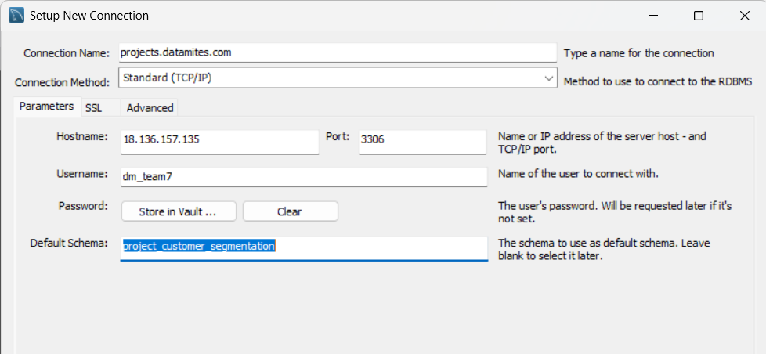
Database connection :
Database connection from given credentials:
Connect the database with MySQL Workbench using the credentials provided.

Slide 9
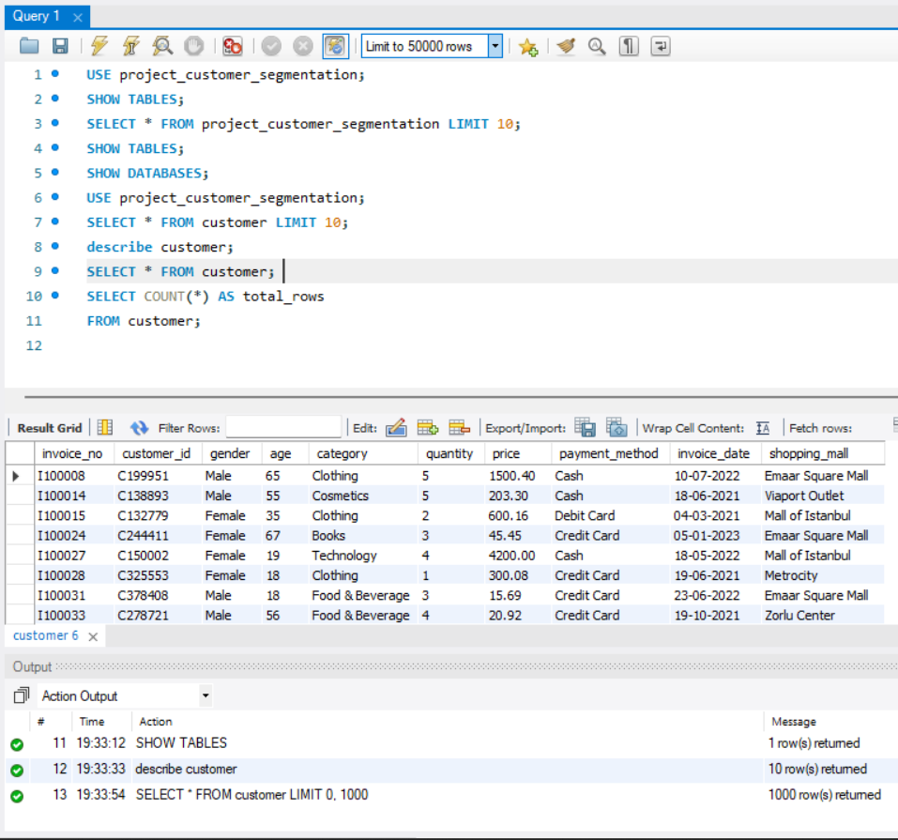
Now using SQL Query (select * from customer) get the data.

Slide 10
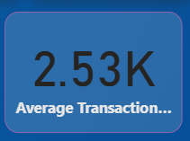
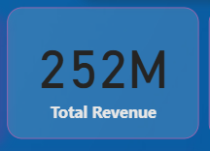
Overview : Customer data Analysis
KPI – Average Transaction value – created a DAX measure 1. Average transaction value = 2.53 K = DIVIDE([Total Revenue], DISTINCTCOUNT('project_customer_segmentation customer'[invoice_no]))
2. Total Revenue = 252 M SUMX('project_customer_segmentation customer','project_customer_segmentation customer'[quantity] * 'project_customer_segmentation customer'[price]) Insight: The maximum revenue by gender is from Females 150M. The maximum Revenue is from Age_group 36-45 (Adults middle age group) is 50M (50,184,235)

Slide 11
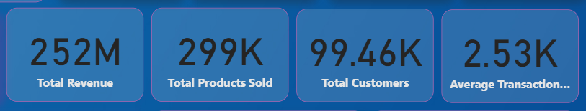
KPIs
Total Revenue is 252 millions, while maximum Revenue is from Clothing category. 1.Primary Payment Source: Credit Card and Cash are the two payment options generating the highest revenue. It is crucial to ensure customers receive a fast and secure transaction process for both these methods. 2. Debit Card Opportunity: Debit Card usage accounts for very low revenue contribution. There is a significant opportunity to attract customers using debit cards through special discounts or reward points.
3. Cash Management: Since cash transactions account for a large share of total sales, focus must be placed on accurate cash handling and security to prevent theft.

Slide 12
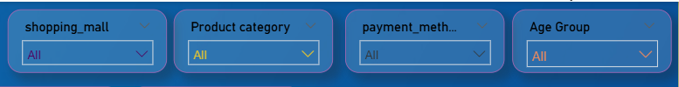
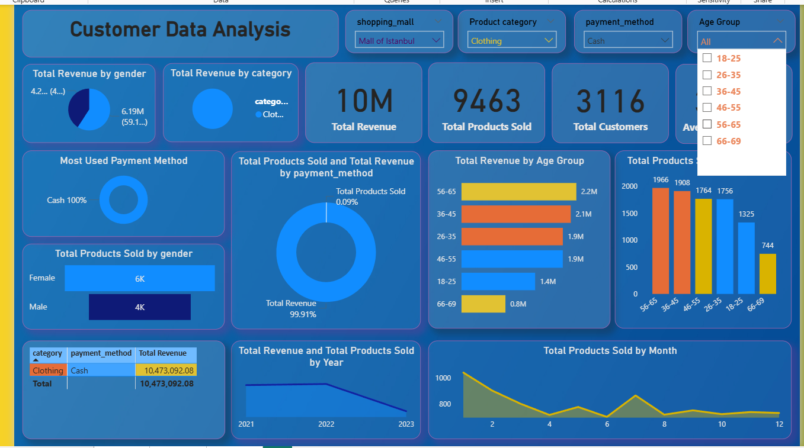
Slicers To Filter and Track Data :
Here for eg. –
Shopping mall- Mall of Istambul
Product category- Clothing
Payment method- Cash
Following Insights can be generated: For The mall of Istambul, the revenue was generated is 10 Million,Total ProductsSold was 9K, which is the highest units sold, Total customers are 3116, Average Transaction value was 3.36K .
Also the Revenue generated via Cash payments which was the highest 99.91%. TSA: Total Revenue and Total Products sold were gone decreasing from year 2022, 4.8 M to 85.9 K in 2023 Year.

Slide 13
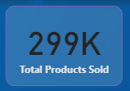
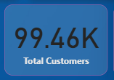
Total Customers and total products sold
For KPI – Total Products Sold = 299K
3.Total Products Sold = SUM('project_customer_segmentation customer'[quantity])
4. Total Customers = 99.46K Total Customers = Total Customer ID
Insight: The Clothing category dominates sales contribution, clearly indicating high consumer preference; continuous inventory stocking and strategic sourcing are required to meet the increased demand in this category. Categories such as Technology and Books contribute minimally to overall revenue, suggesting a need for new marketing campaigns.

Slide 14
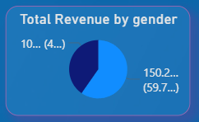
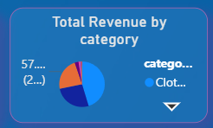
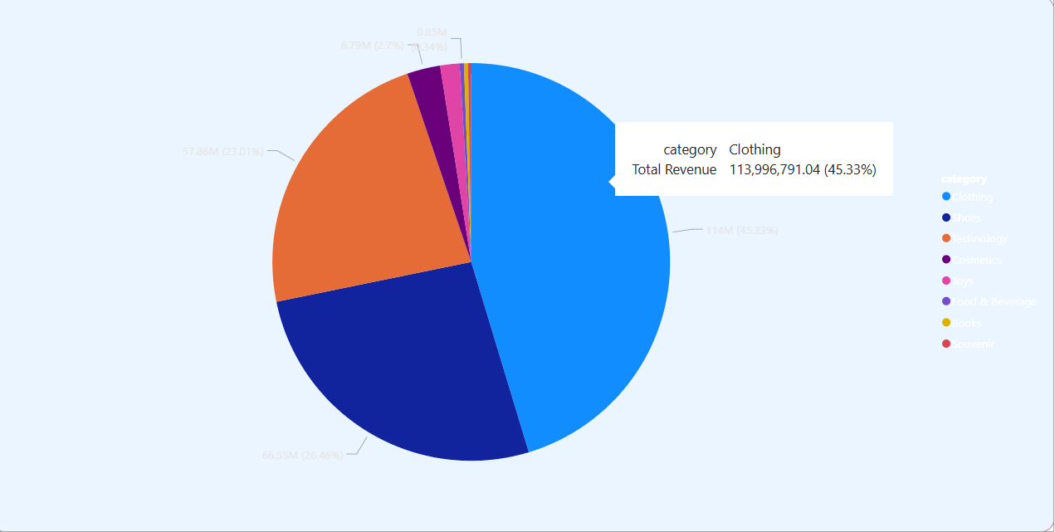
Total revenue by gender and category
Total Revenue by Gender : According to Gender category, female have made more Revenue 150Million (59.72%), while by Male have made 101 Million(40.28%) Revenue which is so less as compare to Female shopping habits.
Total Revenue by category: The clothing category have made the largest share of total revenue, while books and souvenir have less, Immediate focus is needed to investigate the reasons behind this poor performance (e.g., pricing, current trends) and implement targeted strategies for sales improvement.

Slide 15
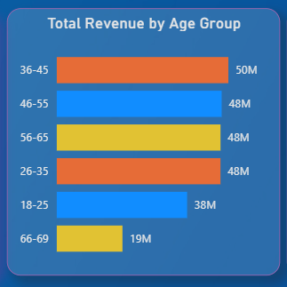
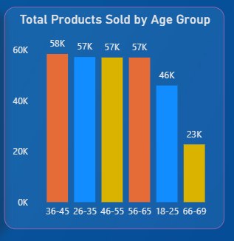
Shopping distribution according to age:
Total Revenue by Age Group : Age-Group category 36-45 this Age group generated more revenue 50,184,235, (50 M)
Total Products Sold by Age Group: Age group 36-45 this age group purchased more products.
Insights:
1. High-Value Customer Base: The 36-45 age group is the most financially valuable segment, contributing the highest total revenue.
2. Shopping Frequency Leader: In terms of volume, the 36-45 age group purchased the largest quantity of products (total products sold).
3. Targeted Growth Opportunity: The younger 18–30 age group shows lower sales volume and revenue compared to the core segments. Tailored digital and trend-based marketing could significantly boost their engagement and drive up their purchase value.

Slide 16
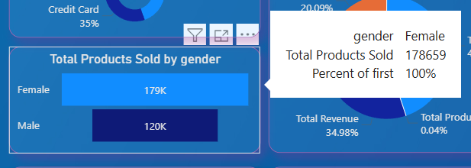
Distribution Of Purchase Categories relative to gender:
Total product sold by gender : More products are purchased by female(179K) as compare to male (120K). Key Insights: 1. Primary Customer Segment: Female customers are the dominant segment, contributing the highest volume of products sold and highest total revenue.
2. Male growth opportunity: less products purchased, there is a significant opportunity to increase their engagement and spending via targeted products offerings and marketing campaigns.

Slide 17
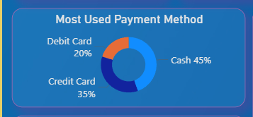
Payment Method Distribution:
Most used payment method: The most used payment method is by cash 45%, and less used Debit cards 20%.
Key Insights:
Value Vs. Frequency: Cash transactions generate the highest total revenue, while credit card transactions have the highest frequency (count), This implies that cash buyers have a higher average basket value, while credit card users shop more often.
Debit Card Opportunity: Debit Card usage is the lowest across all key metrics(revenue, volume, count), This represents a significant untapped segment where incentives or rewards should be focused to encourage digital adoption.

Slide 18
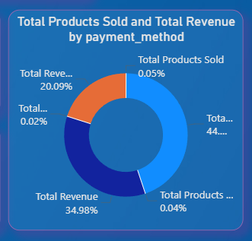
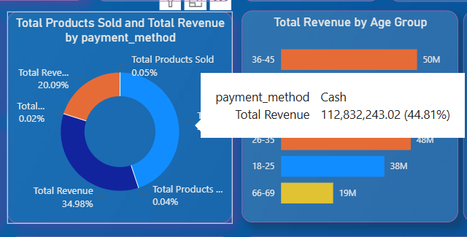
Total Products Sold And Total Revenue By Payment Method:
3. Cash Transaction Risk: The large contribution and high value of cash transactions increase operational risks associated with security and need for rigorous cash handling.
4. Digital shift direction: Incentivizing the use of digital payment methods (Debit/Credit Card) is strategically important to reduce long term operational costs associated with cash handling.

Slide 19
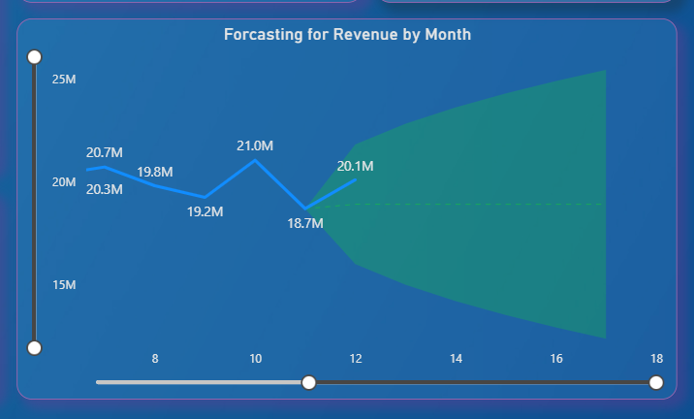
Revenue And Total Products Sold Forecast – 6 months Forecast :
Forecasting for Revenue by Month : The Revenue forecast remains at approximately 18.9 Million monthly.
Stable Mean: The base revenue forecast remains flat at approx. 18.92 Million per month (Month 13–18 means next months 1-6 Jan-June)
Below Actuals: This projected mean is lower than the most recent actual revenue recorded in month 12 (20.1 million)
Rising Uncertainty: Forecast volatility is increasing significantly, evidenced by the confidence interval widening from 7.8 million (M13) to over 13 million (M17).

Slide 20
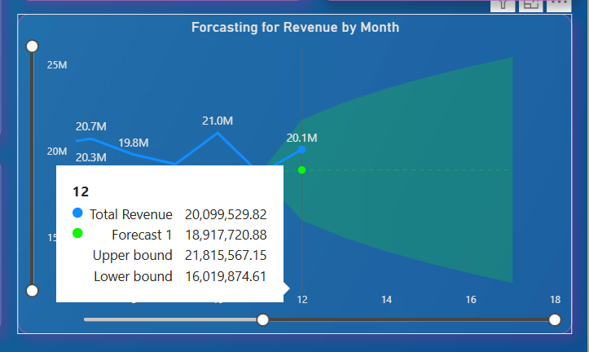
Revenue Projection:
The mean forecast remains steady at $18.92 million monthly.

Slide 21
Revenue 6 Months Forecast :
Revenue Projections (Month 13-18)
Month | Forecast 1 (Base) (in million) | Upper Bound (Optimistic) | Lower Bound (Pessimistic) | Confidence Interval (Range)
12 (Actual) | 20.10 M | $ 22.8 M | $ 16 M | $ 7 M
13 (Start) | $ 18.92 M | $22.81 M | $ 15.02 M | $7.80 M
14 | $ 18.92 M | $23.60 M | $14.22 M | $9.3 M
15 | $ 18.92 M | $24.28 M | $13.55 M | $10.73 M
16 | $ 18.92 M | $24.8 M | $12.95 M | $11.93 M
17 | $ 18.92 M | $25.42 M | $12.40 M | $13.02 M

Slide 22
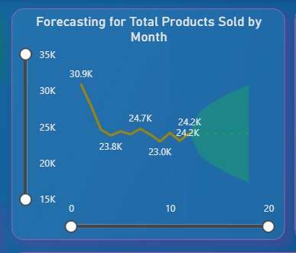
Total Products Sold Forecast- 6 Months Forecast
Key Insights and Findings :
1. Stable Mean: The base forecast for Total Products Sold is flat at approx. 24,058 units per month (month 13-18 means Jan-June).
2. Below Last Actual: This projected average is significantly below the last actual data point displayed on the chart (Month 12 Actual: 24K units).

Slide 23
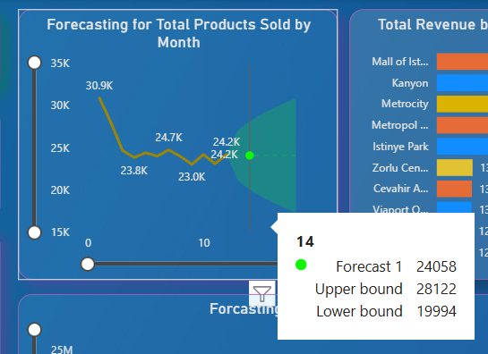
Forecasting For Total Products -
Key Insights: 3. Rising Uncertainty: Forecast volatility is increasing rapidly, with the confidence interval (Upper to Lower Bound) widening from 5,921 units (M13) to over 13,576 units (M18).

Slide 24
Cumulative 6-month Forecast Table (Revenue & Units) :
2. Products Sold Projections: (Month 13-18)
Month | Forecast 1 (Base) | Upper Bound | Lower Bound | Interval (Uncertainty Range)
13 (Start) | 24,058 | 27,079 | 21,038 | 6,041
14 | 24,058 | 28,122 | 19,994 | 8,128
15 | 24,058 | 28,948 | 19,169 | 9,779
16 | 24,058 | 29,653 | 18,464 | 11,189
17 | 24,058 | 30,278 | 17,839 | 12,439
18 (End) | 24,058 | 30,846 | 17,270 | 13,576
Metric | Month 18 Forecast | Upper Bound | Lower Bound
Revenue | $18,917,721 M | $25,920,417 M | $11,915,025 M
Total Products Sold | 24,058 units | 30,846 units | 17,270 units

Slide 25
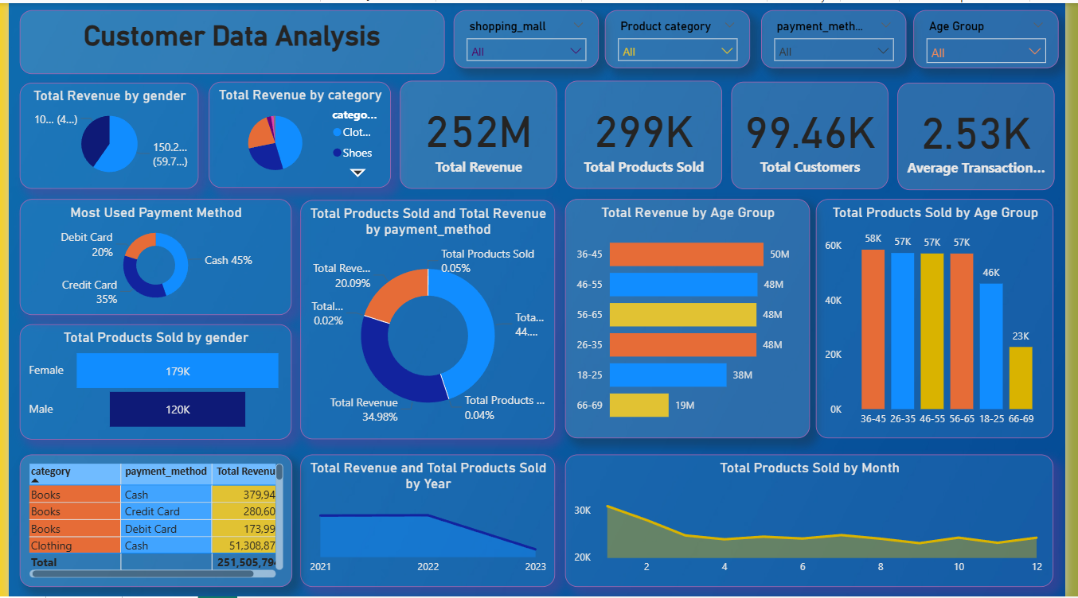
Dashboard View :

Slide 26
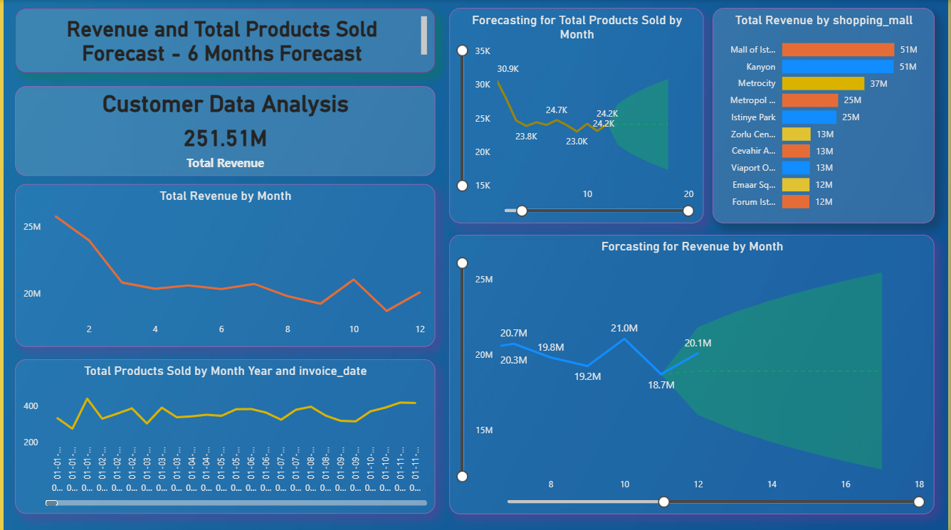
Dashboard View :
(Page 2)

Slide 27
Conclusion :
LEARNING:
Incorporated data analysis techniques,
Specializing in time series analysis,
To deliver valuable insights,
Accurate sales forecasting, and interactive dashboard creation,
Driving business success.
Record video & Dashboard link : https://drive.google.com/drive/folders/10x5WM8Bcy_zgCULR9JlVzqB_VWt_GjI?usp=sharing

Slide 28
Thank You
Record Video link: https://drive.google.com/file/d/1MCooeDLQy7T6eIuX3cGirEI9UAkZJSym/view?usp=sharing

